Slide 1
2020 TJMSC Tech. Courses
Raytracing
In One Weekend
Weisi Wang
Tongji Microsoft Student Club
Microsoft Learn Student Ambassadors
Dec. 13, 2020
Room 434, Ji Shi Building SSE, Tongji University

Slide 2

Overview
Output a Image
The Vector3 Class
Rays, a Simple Camera, and Background
Adding a Sphere
Suface Normals and Multiple Objects
Anti-aliasing
Diffuse Material
Metal
Dielectric
Positionable Camera
Defocus Blur
Where Next?
2020 TJMSC Tech. Courses
Raytracing In One Weekend

Slide 3
Overview
What can you get?
Basic Computer Graphics
A little bit of Golang
A simple Ray-tracer
What can NOT you get?
Rendering with APIs (e.g. DirectX, OpenGL, Vulkan)
Computing with Graphics Card (OpenCL, CUDA)
Real-time Rendering
Rendering Optimization
…
2020 TJMSC Tech. Courses
Raytracing In One Weekend

Slide 4
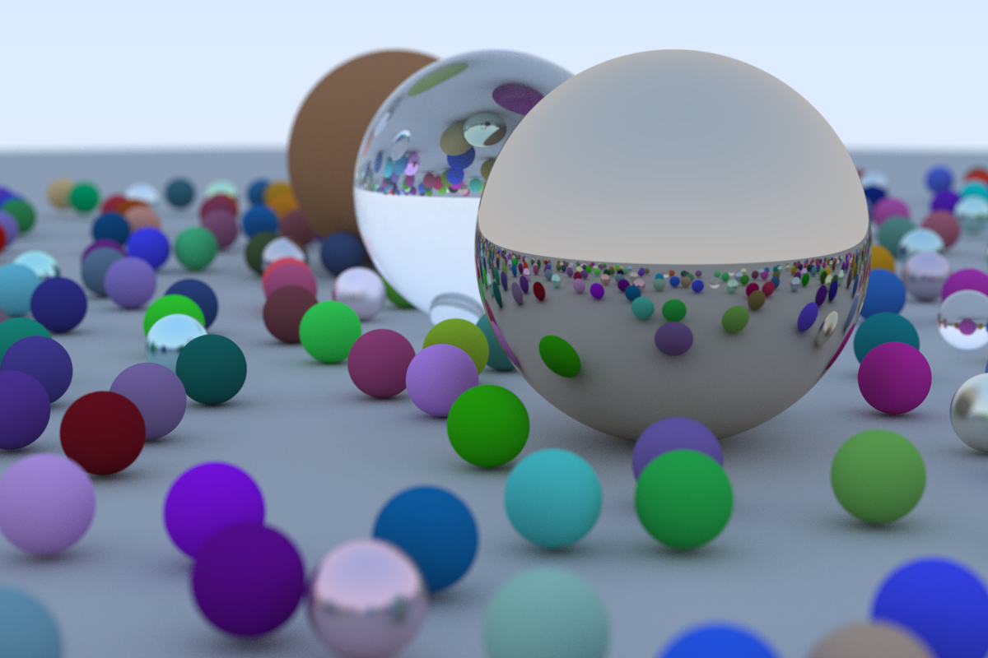
Overview
Our target today!
2020 TJMSC Tech. Courses
Raytracing In One Weekend

Slide 5
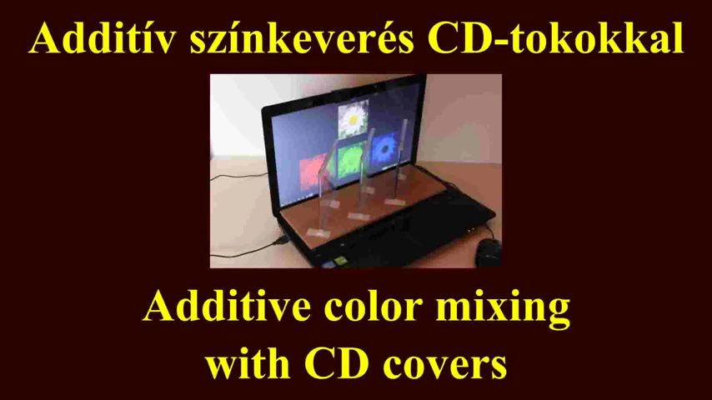
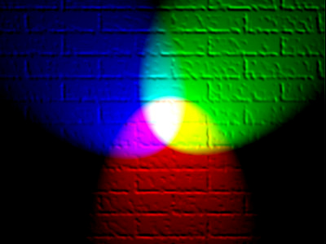
Output a Image
What is color?
RGB Model?
2020 TJMSC Tech. Courses
Raytracing In One Weekend

Slide 6
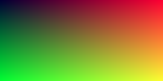
Output a Image
package main
import (
"raytracing-tutorials/utils"
)
func main() {
w, h := 200, 100
img := utils.NewRGBA(w, h)
for j := 0; j < h; j++ {
for i := 0; i < w; i++ {
r := float32(i) / float32(w) * 255.999
g := float32(j) / float32(h) * 255.999
b := float32(0.2) * 255.999
img.SetRGBA(i, j, utils.RGBAFC{r, g, b, 255.0})
}
}
img.SavePNG("result.png")
}
2020 TJMSC Tech. Courses
Raytracing In One Weekend

Slide 7
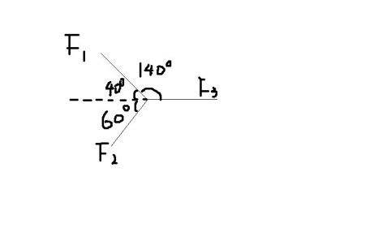
The Vector3 Class
Vector ?
(x, y, z) Stand for?
Data Structure?
2020 TJMSC Tech. Courses
Raytracing In One Weekend

Slide 8
The Vector3 Class
func (v1 *Vector3) Dot(v2 *Vector3) float32 {
return v1.e[0]*v2.e[0] + v1.e[1]*v2.e[1] + v1.e[2]*v2.e[2]
}
func (v *Vector3) LengthSquare() float32 {
return v.Dot(v)
}
func (v *Vector3) Length() float32 {
return Sqrtf(v.LengthSquare())
}
func (v1 *Vector3) Cross(v2 *Vector3) *Vector3 {
return NewVector3(
v1.e[1]*v2.e[2]-v1.e[2]*v2.e[1],
v1.e[2]*v2.e[0]-v1.e[0]*v2.e[2],
v1.e[0]*v2.e[1]-v1.e[1]*v2.e[0],
)
}
func (v *Vector3) Unit() *Vector3 {
return v.DivFVec(v.Length())
}
type Vector4 struct {
e [4]float32
}
type Vector3 Vector4
func NewVector3(x, y, z float32) *Vector3 {
return &Vector3{[4]float32{x, y, z}}
}
2020 TJMSC Tech. Courses
Raytracing In One Weekend

Slide 9
The Vector3 Class
package main
import (
"raytracing-tutorials/utils"
)
func main() {
w, h := 200, 100
img := utils.NewRGBA(w, h)
for j := 0; j < h; j++ {
for i := 0; i < w; i++ {
r := float32(i) / float32(w) * 255.999
g := float32(j) / float32(h) * 255.999
b := float32(0.2) * 255.999
img.SetRGBA(i, j, utils.RGBAFC{r, g, b, 255.0})
}
}
img.SavePNG("result.png")
}
2020 TJMSC Tech. Courses
Raytracing In One Weekend

Slide 10
The Vector3 Class
package main
import (
"raytracing-tutorials/utils"
)
func main() {
w, h := 200, 100
img := utils.NewRGBA(w, h)
for j := 0; j < h; j++ {
for i := 0; i < w; i++ {
r := float32(i) / float32(w)
g := float32(j) / float32(h)
b := float32(0.2)
img.SetRGB(i, j, utils.NewVector3(r, g, b))
}
}
img.SavePNG("result.png")
}
2020 TJMSC Tech. Courses
Raytracing In One Weekend

Slide 11
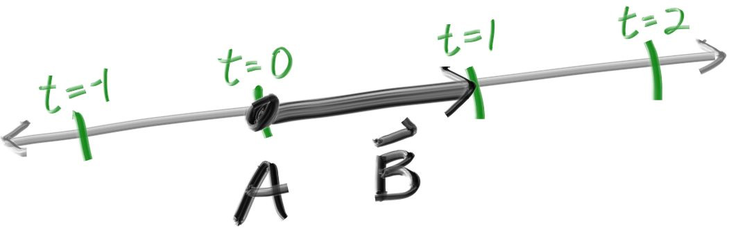
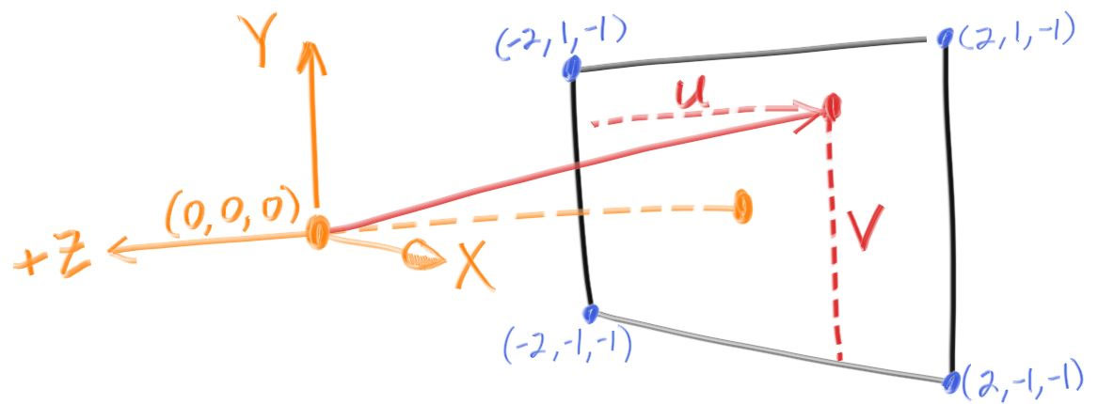
Rays, a Simple Camera, and Background
package utils
type Ray struct {
Origin, Direction *Vector3
}
func (r *Ray) At(t float32) *Vector3 {
return r.Origin.AddVec(r.Direction.MulFVec(t))
}
func NewRay(ori, dir *Vector3) *Ray {
return &Ray{ori, dir}
}
2020 TJMSC Tech. Courses
Raytracing In One Weekend

Slide 12
Rays, a Simple Camera, and Background
package main
import (
"raytracing-tutorials/utils"
)
func main() {
w, h := 200, 100
img := utils.NewRGBA(w, h)
for j := 0; j < h; j++ {
for i := 0; i < w; i++ {
r := float32(i) / float32(w)
g := float32(j) / float32(h)
b := float32(0.2)
img.SetRGB(i, j, utils.NewVector3(r, g, b))
}
}
img.SavePNG("result.png")
}
2020 TJMSC Tech. Courses
Raytracing In One Weekend

Slide 13

Rays, a Simple Camera, and Background
package main import (
"raytracing-tutorials/utils"
) func main() {
w, h := 200, 100
img := utils.NewRGBA(w, h) lower_left_corner := utils.NewVector3(-2.0, -1.0, -1.0)
horizontal := utils.NewVector3(4.0, 0.0, 0.0)
vertical := utils.NewVector3(0.0, 2.0, 0.0)
origin := utils.NewVector3(0.0, 0.0, 0.0) for j := 0; j < h; j++ {
for i := 0; i < w; i++ {
u := float32(i) / float32(w)
v := float32(j) / float32(h)
dir := lower_left_corner.AddVec(horizontal.MulFVec(u))
dir.Add(vertical.MulFVec(v))
r := utils.NewRay(origin, dir)
color := RayColor(r)
img.SetRGB(i, h-j-1, color)
}
}
img.SavePNG("result.png")
}
2020 TJMSC Tech. Courses
Raytracing In One Weekend

Slide 14
Rays, a Simple Camera, and Background
func RayColor(r *utils.Ray) *utils.Vector3 {
t := (r.Direction.Unit().Y() + 1.0) * 0.5
v := utils.NewVector3(0.5, 0.7, 1.0)
v.MulF(t)
v.AddF(1.0 - t)
return v
}
2020 TJMSC Tech. Courses
Raytracing In One Weekend

Slide 15
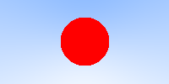
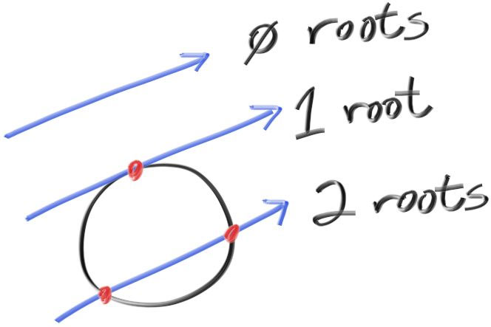
Adding a Sphere
func HitSphere(ball *utils.Vector4, r *utils.Ray) bool {
center := utils.ToVector3(ball)
oc := r.Origin.SubVec(center)
a := r.Direction.LengthSquare()
b := 2.0 * oc.Dot(r.Direction)
c := oc.LengthSquare() - ball.W()*ball.W()
discriminant := b*b - 4*a*c
return (discriminant > 0)
}
func RayColor(r *utils.Ray) *utils.Vector3 {
if HitSphere(utils.NewVector4(0, 0, -1, 0.5), r) {
return utils.NewVector3(1, 0, 0)
}
t := (r.Direction.Unit().Y() + 1.0) * 0.5
v := utils.NewVector3(0.5, 0.7, 1.0)
v.MulF(t)
v.AddF(1.0 - t)
return v
}
2020 TJMSC Tech. Courses
Raytracing In One Weekend

Slide 16
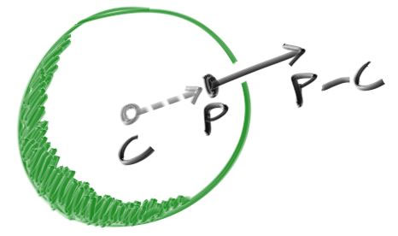
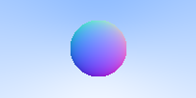
Suface Normals and Multiple Objects
func HitSphere(ball *utils.Vector4, r *utils.Ray) float32 {
center := utils.ToVector3(ball)
oc := r.Origin.SubVec(center)
a := r.Direction.LengthSquare()
b := 2.0 * oc.Dot(r.Direction)
c := oc.LengthSquare() - ball.W()*ball.W()
discriminant := b*b - 4*a*c
if discriminant < 0.0 {
return -1.0
} else {
return (-b - utils.Sqrtf(discriminant)) / (2.0 * a)
}
}
func RayColor(r *utils.Ray) *utils.Vector3 {
t := HitSphere(utils.NewVector4(0.0, 0.0, -1.0, 0.5), r)
if t > 0.0 {
N := r.At(t).SubVec(utils.NewVector3(0.0, 0.0, -1.0)).Unit()
N.AddF(1.0)
N.MulF(0.5)
return N
}
t = (r.Direction.Unit().Y() + 1.0) * 0.5
v := utils.NewVector3(0.5, 0.7, 1.0)
v.MulF(t)
v.AddF(1.0 - t)
return v
}
2020 TJMSC Tech. Courses
Raytracing In One Weekend

Slide 17
Suface Normals and Multiple Objects
type HitTable interface {
Hit(r *Ray, tMin, tMax float32) *HitRecord
}
type Sphere struct {
v *Vector4
}
func (s *Sphere) Hit(r *Ray, tMin, tMax float32) *HitRecord {
center := ToVector3(s.v)
oc := r.Origin.SubVec(center)
a := r.Direction.LengthSquare()
b := oc.Dot(r.Direction)
c := oc.LengthSquare() - s.v.W()*s.v.W()
discriminant := b*b - a*c
if discriminant < 0.0 {
return nil
}
root := Sqrtf(discriminant)
t := (-b - root) / a
if t < tMin || tMax < t {
t = (-b + root) / a
if t < tMin || tMax < t {
return nil
}
}
p := r.At(t)
return NewHitRecordWithRayMat(
p,
p.SubVec(center).DivFVec(s.v.W()),
t,
r,
s.Mat,
)
}
2020 TJMSC Tech. Courses
Raytracing In One Weekend

Slide 18
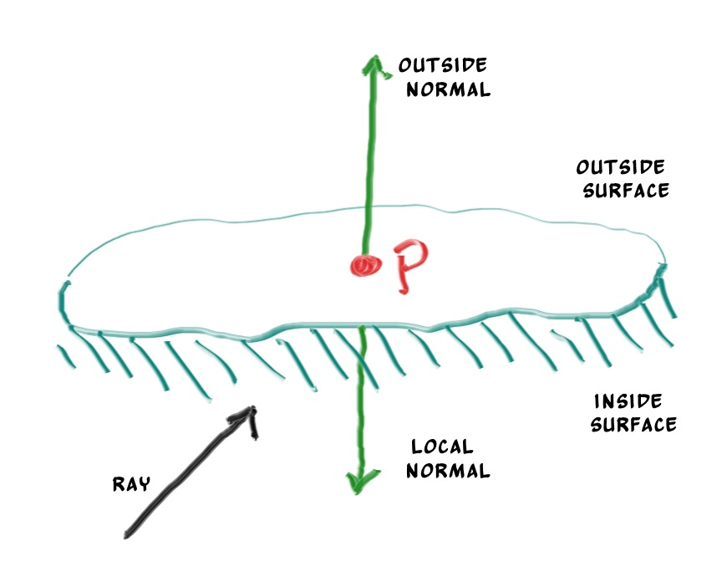
Suface Normals and Multiple Objects
type HitRecord struct {
P, Normal *Vector3
T float32
FrontFace bool
}
func (hr *HitRecord) SetFaceNormal(r *Ray) {
hr.FrontFace = r.Direction.Dot(hr.Normal) < 0.0
if !hr.FrontFace {
hr.Normal.MulF(-1.0)
}
}
2020 TJMSC Tech. Courses
Raytracing In One Weekend

Slide 19
Suface Normals and Multiple Objects
type HitTableList struct {
Objects []HitTable
}
func (htl *HitTableList) Hit(r *Ray, tMin, tMax float32) *HitRecord {
var ret *HitRecord = nil
closestSoFar := tMax
for i := range htl.Objects {
hr := htl.Objects[i].Hit(r, tMin, closestSoFar)
if hr != nil {
ret = hr
closestSoFar = hr.T
}
}
return ret
}
func (htl *HitTableList) Add(obj HitTable) {
htl.Objects = append(htl.Objects, obj)
}
2020 TJMSC Tech. Courses
Raytracing In One Weekend

Slide 20
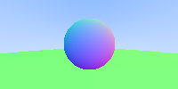
Suface Normals and Multiple Objects
func RayColor(r *utils.Ray, world utils.HitTable) *utils.Vector3 {
if rec := world.Hit(r, 0, utils.Inf32(1)); rec != nil {
rec.Normal.AddF(1.0)
rec.Normal.MulF(0.5)
return rec.Normal
}
t := 0.5 * (r.Direction.Unit().Y() + 1.0)
v1 := utils.NewVector3(1.0, 1.0, 1.0)
v1.MulF(1.0 - t)
v2 := utils.NewVector3(0.5, 0.7, 1.0)
v2.MulF(t)
v1.Add(v2)
return v1
}
func main() {
......
origin := utils.NewVector3(0.0, 0.0, 0.0)
world := utils.NewHitTableList()
world.Add(utils.NewSphere(utils.NewVector3(0.0, 0.0, -1), 0.5))
world.Add(utils.NewSphere(utils.NewVector3(0.0, -100.5, -1), 100))
for j := 0; j < h; j++ {
for i := 0; i < w; i++ {
......
color := RayColor(r, world)
img.SetRGB(i, h-j-1, color)
}
}
img.SavePNG("result.png")
}
2020 TJMSC Tech. Courses
Raytracing In One Weekend

Slide 21
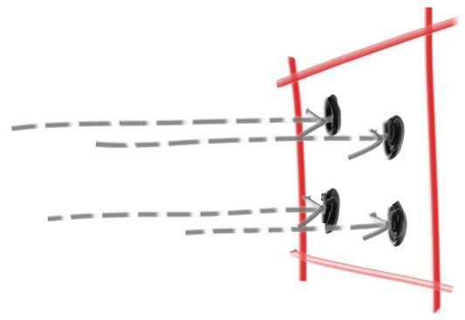
Anti-aliasing
type Camera struct {
Origin *Vector3
LowerLeftCorner *Vector3
Horizontal *Vector3
Vertical *Vector3
u, v, w *Vector3
lenRadius float32
}
func NewCamera() *Camera {
return &Camera{
NewVector3(0.0, 0.0, 0.0),
NewVector3(-2.0, -1.0, -1.0),
NewVector3(4.0, 0.0, 0.0),
NewVector3(0.0, 2.0, 0.0),
nil, nil, nil, 0.0,
}
}
func (c *Camera) GetRay(u, v float32) *Ray {
dir := c.LowerLeftCorner.AddVec(c.Horizontal.MulFVec(u))
dir.Add(c.Vertical.MulFVec(v))
dir.Sub(c.Origin)
return NewRay(c.Origin, dir)
}
2020 TJMSC Tech. Courses
Raytracing In One Weekend

Slide 22
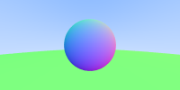
Anti-aliasing
func main() {
img := utils.NewRGBA(w, h)
cam := utils.NewCamera()
......
for j := 0; j < h; j++ {
for i := 0; i < w; i++ {
color := utils.NewVector3(0.0, 0.0, 0.0)
for k := 0; k < samplesPerPixel; k++ {
u := (float32(i) + utils.Randf()) / float32(w)
v := (float32(j) + utils.Randf()) / float32(h)
r := cam.GetRay(u, v)
color.Add(RayColor(r, world))
}
color.MulF(1.0 / samplesPerPixel)
img.SetRGB(i, h-j-1, color)
}
}
img.SavePNG("result.png")
}
2020 TJMSC Tech. Courses
Raytracing In One Weekend

Slide 23
Overview
Output a Image
The Vector3 Class
Rays, a Simple Camera, and Background
Adding a Sphere
Suface Normals and Multiple Objects
Anti-aliasing
Diffuse Material
Metal
Dielectric
Positionable Camera
Defocus Blur
Where Next?
2020 TJMSC Tech. Courses
Raytracing In One Weekend

Slide 24
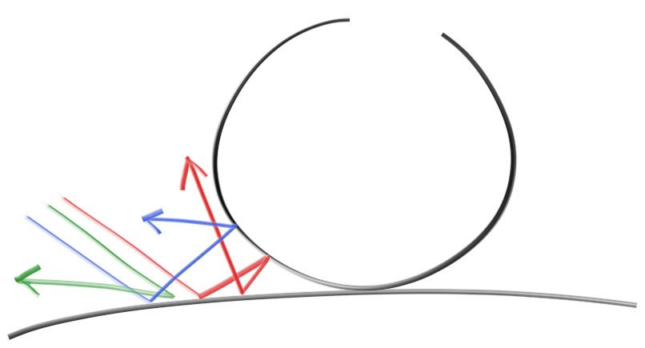
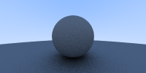
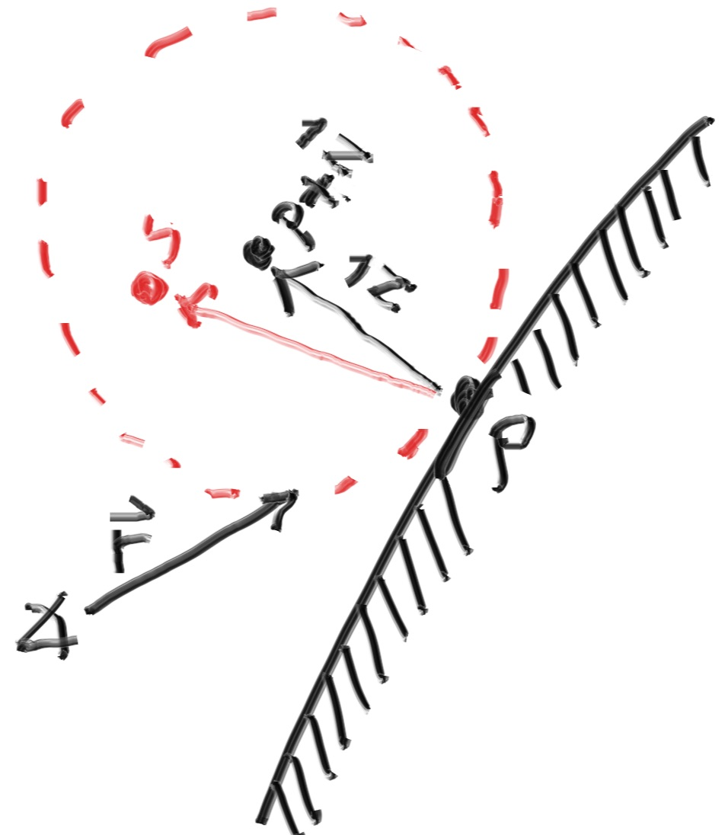
Diffuse Material
func NewRandomVector3InUnitSphere() *Vector3 {
for true {
p := NewRandomVector3MinMax(-1, 1)
if p.LengthSquare() >= 1 {
continue
}
return p
}
return nil
}
func RayColor(r *utils.Ray, world utils.HitTable, depth int) *utils.Vector3 {
if depth <= 0 {
return utils.NewVector3(0.0, 0.0, 0.0)
} if rec := world.Hit(r, 0.001, utils.Inf32(1)); rec != nil {
rec.Normal.Add(utils.NewRandomVector3InUnitSphere())
ret := RayColor(utils.NewRay(rec.P, rec.Normal), world, depth-1)
ret.MulF(0.5)
return ret
} ......
}
2020 TJMSC Tech. Courses
Raytracing In One Weekend

Slide 25
Diffuse Material
for j := 0; j < h; j++ {
utils.PrintProgress(j, h)
for i := 0; i < w; i++ {
color := utils.NewVector3(0.0, 0.0, 0.0)
for k := 0; k < samplesPerPixel; k++ {
u := (float32(i) + utils.Randf()) / float32(w)
v := (float32(j) + utils.Randf()) / float32(h)
r := cam.GetRay(u, v)
color.Add(RayColor(r, world, maxDepth))
}
color.MulF(1.0 / samplesPerPixel)
// color.Sqrt()
img.SetRGB(i, h-j-1, color)
}
}
2020 TJMSC Tech. Courses
Raytracing In One Weekend

Slide 26
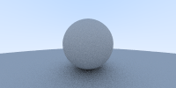
Diffuse Material
for j := 0; j < h; j++ {
utils.PrintProgress(j, h)
for i := 0; i < w; i++ {
color := utils.NewVector3(0.0, 0.0, 0.0)
for k := 0; k < samplesPerPixel; k++ {
u := (float32(i) + utils.Randf()) / float32(w)
v := (float32(j) + utils.Randf()) / float32(h)
r := cam.GetRay(u, v)
color.Add(RayColor(r, world, maxDepth))
}
color.MulF(1.0 / samplesPerPixel)
color.Sqrt()
img.SetRGB(i, h-j-1, color)
}
}
2020 TJMSC Tech. Courses
Raytracing In One Weekend

Slide 27
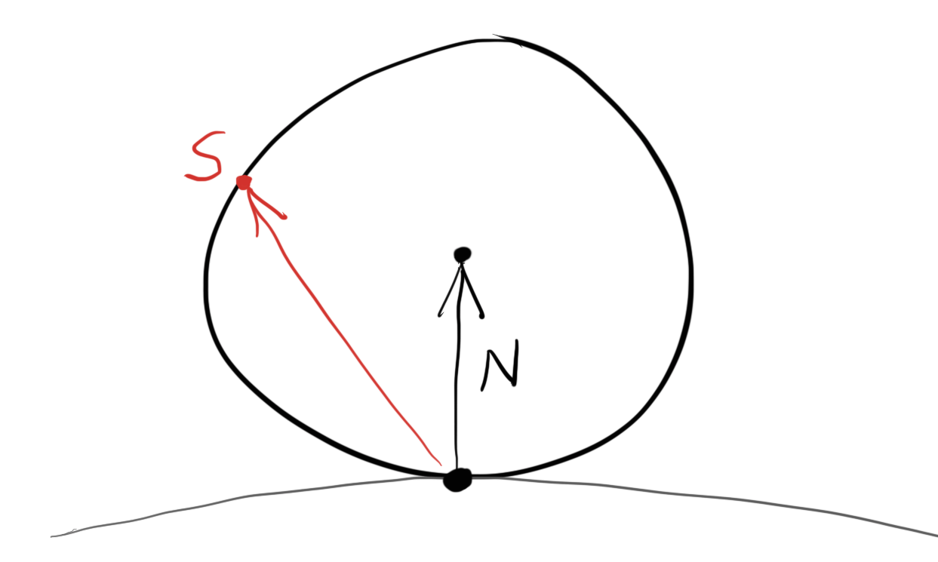
Diffuse Material
func NewRandomUnitVector3() *Vector3 {
a := RandfMinMax(0, 2*PI)
z := RandfMinMax(-1, 1)
r := Sqrtf(1 - z*z)
return NewVector3(r*math32.Cos(a), r*math32.Sin(a), z)
}
if rec := world.Hit(r, 0.001, utils.Inf32(1)); rec != nil {
rec.Normal.Add(utils.NewRandomVector3InUnitSphere())
ret := RayColor(utils.NewRay(rec.P, rec.Normal), world, depth-1)
ret.MulF(0.5)
return ret
}
2020 TJMSC Tech. Courses
Raytracing In One Weekend

Slide 28
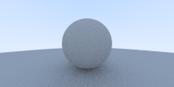
Diffuse Material
func NewRandomUnitVector3() *Vector3 {
a := RandfMinMax(0, 2*PI)
z := RandfMinMax(-1, 1)
r := Sqrtf(1 - z*z)
return NewVector3(r*math32.Cos(a), r*math32.Sin(a), z)
}
if rec := world.Hit(r, 0.001, utils.Inf32(1)); rec != nil {
rec.Normal.Add(utils. NewRandomUnitVector3())
ret := RayColor(utils.NewRay(rec.P, rec.Normal), world, depth-1)
ret.MulF(0.5)
return ret
}
2020 TJMSC Tech. Courses
Raytracing In One Weekend

Slide 29
Diffuse Material
func NewRandomVector3InHemisphere(normal *Vector3) *Vector3 {
inUnitSphere := NewRandomVector3InUnitSphere()
if inUnitSphere.Dot(normal) <= 0.0 {
inUnitSphere.MulF(-1.0)
}
return inUnitSphere
}
if rec := world.Hit(r, 0.001, utils.Inf32(1)); rec != nil {
rec.Normal.Add(utils. NewRandomUnitVector3())
ret := RayColor(utils.NewRay(rec.P, rec.Normal), world, depth-1)
ret.MulF(0.5)
return ret
}
2020 TJMSC Tech. Courses
Raytracing In One Weekend

Slide 30
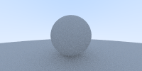
Diffuse Material
func NewRandomVector3InHemisphere(normal *Vector3) *Vector3 {
inUnitSphere := NewRandomVector3InUnitSphere()
if inUnitSphere.Dot(normal) <= 0.0 {
inUnitSphere.MulF(-1.0)
}
return inUnitSphere
}
if rec := world.Hit(r, 0.001, utils.Inf32(1)); rec != nil {
ret := RayColor(utils.NewRay(rec.P, utils.NewRandomVector3InHemisphere(rec.Normal)), world, depth-1)
ret.MulF(0.5)
return ret
}
2020 TJMSC Tech. Courses
Raytracing In One Weekend

Slide 31
Metal Material
type Material interface {
Scatter(r_in *Ray, rec *HitRecord) (*Vector3, *Ray)
}
type Sphere struct {
v *Vector4
}
type HitRecord struct {
P, Normal *Vector3
T float32
FrontFace bool
}
2020 TJMSC Tech. Courses
Raytracing In One Weekend

Slide 32
Metal Material
type Material interface {
Scatter(r_in *Ray, rec *HitRecord) (*Vector3, *Ray)
}
type Sphere struct {
v *Vector4
Mat Material
}
type HitRecord struct {
P, Normal *Vector3
T float32
FrontFace bool
Mat Material
}
type Lambertian struct {
Albedo *Vector3
}
func (l *Lambertian) Scatter(r_in *Ray, rec *HitRecord) (*Vector3, *Ray) {
dir := rec.Normal.AddVec(NewRandomUnitVector3())
scattered := NewRay(rec.P, dir)
attenuation := CopyVector3(l.Albedo)
return attenuation, scattered
}
2020 TJMSC Tech. Courses
Raytracing In One Weekend

Slide 33
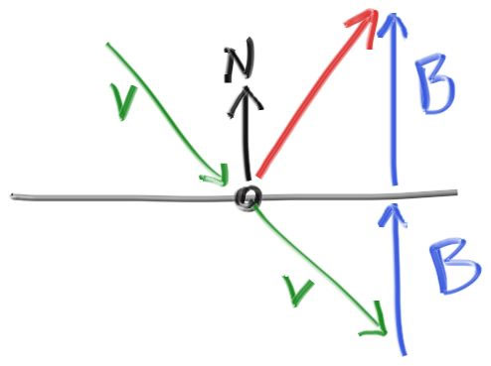
Metal Material
func (v *Vector3) Reflect(n *Vector3) *Vector3 {
n1 := n.MulFVec(2.0 * v.Dot(n))
return v.SubVec(n1)
}
type Metal struct {
Albedo *Vector3
Fuzz float32
}
func (m *Metal) Scatter(r_in *Ray, rec *HitRecord) (*Vector3, *Ray) {
reflected := r_in.Direction.Unit().Reflect(rec.Normal)
randV := NewRandomVector3InUnitSphere()
randV.MulF(m.Fuzz)
reflected.Add(randV)
scattered := NewRay(rec.P, reflected)
attenuation := CopyVector3(m.Albedo)
if scattered.Direction.Dot(rec.Normal) <= 0.0 {
return nil, nil
}
return attenuation, scattered
}
2020 TJMSC Tech. Courses
Raytracing In One Weekend

Slide 34
Metal Material
func RayColor(r *utils.Ray, world utils.HitTable, depth int) *utils.Vector3 {
if depth <= 0 {
return utils.NewVector3(0.0, 0.0, 0.0)
}
if rec := world.Hit(r, 0.001, utils.Inf32(1)); rec != nil {
ret := RayColor(utils.NewRay(rec.P, utils.NewRandomVector3InHemisphere(rec.Normal)), world, depth-1)
ret.MulF(0.5)
return ret
}
t := 0.5 * (r.Direction.Unit().Y() + 1.0)
v := utils.NewVector3(0.5, 0.7, 1.0)
v.MulF(t)
v.AddF(1.0 - t)
return v
}
2020 TJMSC Tech. Courses
Raytracing In One Weekend

Slide 35
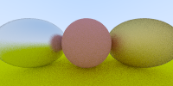
Metal Material
func RayColor(r *utils.Ray, world utils.HitTable, depth int) *utils.Vector3 {
if depth <= 0 {
return utils.NewVector3(0.0, 0.0, 0.0)
}
if rec := world.Hit(r, 0.001, utils.Inf32(1)); rec != nil {
if rec.Mat != nil {
if attenuation, scattered := rec.Mat.Scatter(r, rec); attenuation != nil {
ret := RayColor(scattered, world, depth-1)
ret.Mul(attenuation)
return ret
}
}
return utils.NewVector3(0.0, 0.0, 0.0)
}
t := 0.5 * (r.Direction.Unit().Y() + 1.0)
v := utils.NewVector3(0.5, 0.7, 1.0)
v.MulF(t)
v.AddF(1.0 - t)
return v
}
2020 TJMSC Tech. Courses
Raytracing In One Weekend

Slide 36
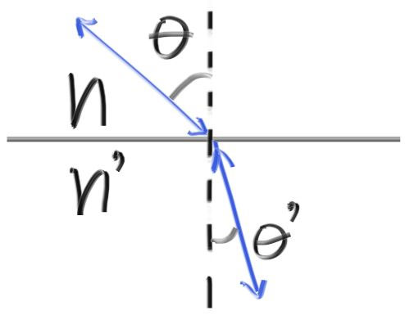
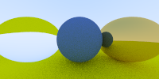
Dielectric Material
func (uv *Vector3) Refract(n *Vector3, etaiOverEtat float32) *Vector3 {
cosTheta := Minf(uv.MulFVec(-1.0).Dot(n), 1.0)
rOutParallel := uv.AddVec(n.MulFVec(cosTheta))
rOutParallel.MulF(etaiOverEtat)
rOutPerp := CopyVector3(n)
rOutPerp.MulF(-Sqrtf(1.0 - rOutParallel.LengthSquare()))
rOutParallel.Add(rOutPerp)
return rOutParallel
}
type Dielectric struct {
RefIdx float32
} func (d *Dielectric) Scatter(r_in *Ray, rec *HitRecord) (*Vector3, *Ray) {
attenuation := NewVector3(1.0, 1.0, 1.0)
refractionRatio := d.RefIdx
if rec.FrontFace {
refractionRatio = 1.0 / refractionRatio
}
unitDirection := r_in.Direction.Unit()
direction := unitDirection.Refract(rec.Normal, refractionRatio)
scattered := NewRay(rec.P, direction)
return attenuation, scattered
}
2020 TJMSC Tech. Courses
Raytracing In One Weekend

Slide 37
Dielectric Material
func (uv *Vector3) Refract(n *Vector3, etaiOverEtat float32) *Vector3 {
cosTheta := Minf(uv.MulFVec(-1.0).Dot(n), 1.0)
rOutParallel := uv.AddVec(n.MulFVec(cosTheta))
rOutParallel.MulF(etaiOverEtat)
rOutPerp := CopyVector3(n)
rOutPerp.MulF(-Sqrtf(1.0 - rOutParallel.LengthSquare()))
rOutParallel.Add(rOutPerp)
return rOutParallel
}
type Dielectric struct {
RefIdx float32
} func (d *Dielectric) Scatter(r_in *Ray, rec *HitRecord) (*Vector3, *Ray) {
attenuation := NewVector3(1.0, 1.0, 1.0)
refractionRatio := d.RefIdx
if rec.FrontFace {
refractionRatio = 1.0 / refractionRatio
}
unitDirection := r_in.Direction.Unit()
direction := unitDirection.Refract(rec.Normal, refractionRatio)
scattered := NewRay(rec.P, direction)
return attenuation, scattered
}
2020 TJMSC Tech. Courses
Raytracing In One Weekend

Slide 38
Dielectric Material
func (d *Dielectric) Scatter(r_in *Ray, rec *HitRecord) (*Vector3, *Ray) {
attenuation := NewVector3(1.0, 1.0, 1.0)
refractionRatio := d.RefIdx
if rec.FrontFace {
refractionRatio = 1.0 / refractionRatio
}
unitDirection := r_in.Direction.Unit()
direction := unitDirection.Refract(rec.Normal, refractionRatio)
scattered := NewRay(rec.P, direction)
return attenuation, scattered
}
2020 TJMSC Tech. Courses
Raytracing In One Weekend

Slide 39
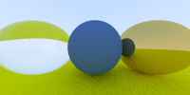
Dielectric Material
func (d *Dielectric) Scatter(r_in *Ray, rec *HitRecord) (*Vector3, *Ray) {
attenuation := NewVector3(1.0, 1.0, 1.0)
refractionRatio := d.RefIdx
if rec.FrontFace {
refractionRatio = 1.0 / refractionRatio
}
unitDirection := r_in.Direction.Unit()
cosTheta := Minf(unitDirection.MulFVec(-1.0).Dot(rec.Normal), 1.0)
sinTheta := Sqrtf(1.0 - cosTheta*cosTheta)
cannotRefract := refractionRatio*sinTheta > 1.0
direction := unitDirection.Reflect(rec.Normal)
if !cannotRefract && reflectance(cosTheta, refractionRatio) < Randf() {
direction = unitDirection.Refract(rec.Normal, refractionRatio)
}
scattered := NewRay(rec.P, direction)
return attenuation, scattered
}
2020 TJMSC Tech. Courses
Raytracing In One Weekend

Slide 40
Dielectric Material
world := utils.NewHitTableList()
world.Add(utils.NewSphereWithMat(utils.NewVector3(0.0, -100.5, -1.0), 100.0,
materialGround))
world.Add(utils.NewSphereWithMat(utils.NewVector3(0.0, 0.0, -1.0), 0.5,
materialCenter))
// world.Add(utils.NewSphereWithMat(utils.NewVector3(-1.0, 0.0, -1.0), -0.45,
// materialLeft))
world.Add(utils.NewSphereWithMat(utils.NewVector3(-1.0, 0.0, -1.0), 0.5,
materialLeft))
world.Add(utils.NewSphereWithMat(utils.NewVector3(1.0, 0.0, -1.0), 0.5,
materialRight))
2020 TJMSC Tech. Courses
Raytracing In One Weekend

Slide 41
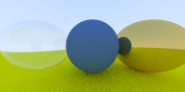
Dielectric Material
world := utils.NewHitTableList()
world.Add(utils.NewSphereWithMat(utils.NewVector3(0.0, -100.5, -1.0), 100.0,
materialGround))
world.Add(utils.NewSphereWithMat(utils.NewVector3(0.0, 0.0, -1.0), 0.5,
materialCenter))
world.Add(utils.NewSphereWithMat(utils.NewVector3(-1.0, 0.0, -1.0), -0.45,
materialLeft))
world.Add(utils.NewSphereWithMat(utils.NewVector3(-1.0, 0.0, -1.0), 0.5,
materialLeft))
world.Add(utils.NewSphereWithMat(utils.NewVector3(1.0, 0.0, -1.0), 0.5,
materialRight))
2020 TJMSC Tech. Courses
Raytracing In One Weekend

Slide 42
Dielectric Material
for j := 0; j < h; j++ {
utils.PrintProgress(j, h)
for i := 0; i < w; i++ {
color := utils.NewVector3(0.0, 0.0, 0.0)
for k := 0; k < samplesPerPixel; k++ {
u := (float32(i) + utils.Randf()) / float32(w)
v := (float32(j) + utils.Randf()) / float32(h)
r := cam.GetRay(u, v)
color.Add(RayColor(r, world, maxDepth))
}
color.MulF(1.0 / samplesPerPixel)
color.Sqrt()
img.SetRGB(i, h-j-1, color)
}
}
2020 TJMSC Tech. Courses
Raytracing In One Weekend

Slide 43
Dielectric Material
for j := 0; j < h; j++ {
utils.PrintProgress(j, h)
wg := sync.WaitGroup{}
for i := 0; i < w; i++ {
wg.Add(1)
go func(i, j int) {
color := utils.NewVector3(0.0, 0.0, 0.0)
for k := 0; k < samplesPerPixel; k++ {
u := (float32(i) + utils.Randf()) / float32(w)
v := (float32(j) + utils.Randf()) / float32(h)
r := cam.GetRay(u, v)
color.Add(RayColor(r, world, maxDepth))
}
color.MulF(1.0 / samplesPerPixel)
color.Sqrt()
img.SetRGB(i, h-j-1, color)
wg.Done()
}(i, j)
}
wg.Wait()
}
2020 TJMSC Tech. Courses
Raytracing In One Weekend

Slide 44
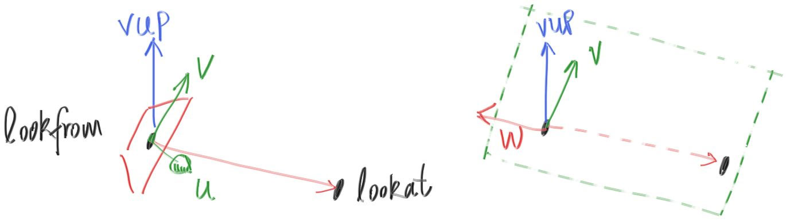
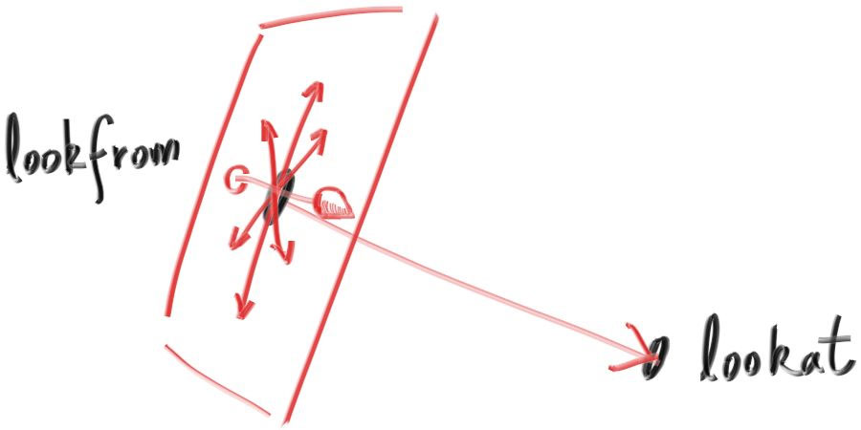
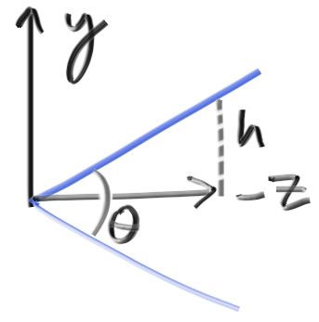
Positionable Camera
type Camera struct {
Origin *Vector3
LowerLeftCorner *Vector3
Horizontal *Vector3
Vertical *Vector3
}
2020 TJMSC Tech. Courses
Raytracing In One Weekend

Slide 45
Positionable Camera
type Camera struct {
Origin *Vector3
LowerLeftCorner *Vector3
Horizontal *Vector3
Vertical *Vector3
u, v, w *Vector3
}
func NewCameraWithOptions(center, lookAt, vUp *Vector3, vFov, aspectRatio float32) *Camera {
theta := ToRadians(vFov)
h := math32.TanGo(theta / 2)
viewportHeight := 2.0 * h
viewportWidth := aspectRatio * viewportHeight
w := center.SubVec(lookAt).Unit()
u := vUp.Cross(w).Unit()
v := w.Cross(u)
u.MulF(viewportWidth)
v.MulF(viewportHeight)
ret := &Camera{
center,
center.SubVec(w),
u,
v,
nil, nil, nil, 0.0,
}
ret.LowerLeftCorner.Add(ret.Horizontal.DivFVec(-2.0))
ret.LowerLeftCorner.Add(ret.Vertical.DivFVec(-2.0))
return ret
}
2020 TJMSC Tech. Courses
Raytracing In One Weekend

Slide 46
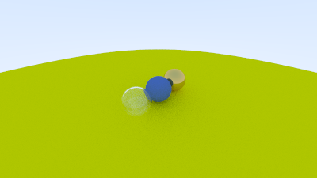
Positionable Camera
cam := utils.NewCameraWithOptions(
utils.NewVector3(-2.0, 2.0, 1.0),
utils.NewVector3(0.0, 0.0, -1.0),
utils.NewVector3(0.0, 1.0, 0.0), 90.0, aspectRatio)
2020 TJMSC Tech. Courses
Raytracing In One Weekend

Slide 47
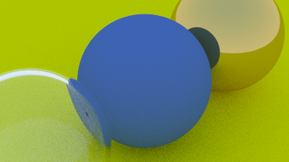
Positionable Camera
cam := utils.NewCameraWithOptions(
utils.NewVector3(-2.0, 2.0, 1.0),
utils.NewVector3(0.0, 0.0, -1.0),
utils.NewVector3(0.0, 1.0, 0.0), 20.0, aspectRatio)
2020 TJMSC Tech. Courses
Raytracing In One Weekend

Slide 48
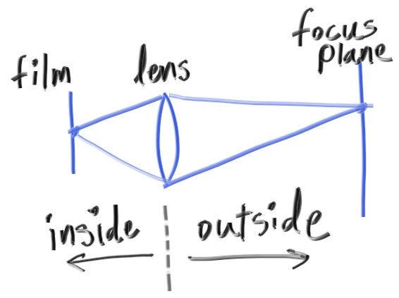
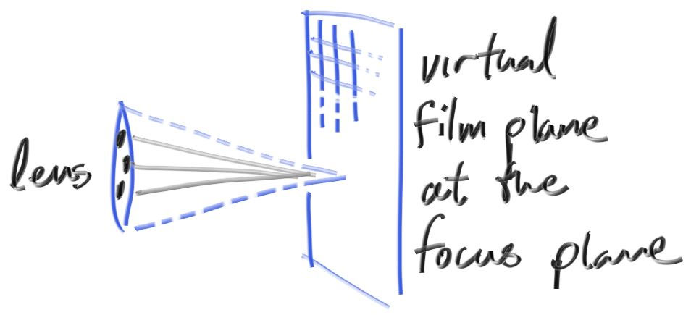
Defocus Blur
type Camera struct {
Origin *Vector3
LowerLeftCorner *Vector3
Horizontal *Vector3
Vertical *Vector3
u, v, w *Vector3
}
2020 TJMSC Tech. Courses
Raytracing In One Weekend

Slide 49
Defocus Blur
type Camera struct {
Origin *Vector3
LowerLeftCorner *Vector3
Horizontal *Vector3
Vertical *Vector3
u, v, w *Vector3
lenRadius float32
}
func (c *Camera) GetRay(u, v float32) *Ray {
dir := c.LowerLeftCorner.AddVec(c.Horizontal.MulFVec(u))
dir.Add(c.Vertical.MulFVec(v))
dir.Sub(c.Origin)
if c.u == nil {
return NewRay(c.Origin, dir)
}
rd := NewRandomVector3InUnitDisk()
rd.MulF(c.lenRadius)
offset := c.u.MulFVec(rd.X()).AddVec(c.v.MulFVec(rd.Y()))
dir.Sub(offset)
return NewRay(c.Origin.AddVec(offset), dir)
}
2020 TJMSC Tech. Courses
Raytracing In One Weekend

Slide 50
Defocus Blur
func NewCameraWithFocusOptions(center, lookAt, vUp *Vector3,
vFov, aspectRatio, aperture, focusDist float32) *Camera {
theta := ToRadians(vFov)
h := math32.TanGo(theta / 2)
viewportHeight := 2.0 * h
viewportWidth := aspectRatio * viewportHeight
w := center.SubVec(lookAt).Unit()
u := vUp.Cross(w).Unit()
v := w.Cross(u)
ret := &Camera{
center,
center.SubVec(w.MulFVec(focusDist)),
u.MulFVec(focusDist * viewportWidth),
v.MulFVec(focusDist * viewportHeight),
u, v, w, aperture / 2.0,
}
ret.LowerLeftCorner.Add(ret.Horizontal.DivFVec(-2.0))
ret.LowerLeftCorner.Add(ret.Vertical.DivFVec(-2.0))
return ret
}
2020 TJMSC Tech. Courses
Raytracing In One Weekend

Slide 51
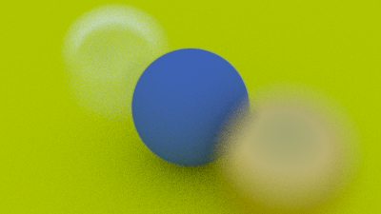
Defocus Blur
lookFrom := utils.NewVector3(3.0, 3.0, 2.0)
lookAt := utils.NewVector3(0.0, 0.0, -1.0)
cam := utils.NewCameraWithFocusOptions(
lookFrom, lookAt, utils.NewVector3(0.0, 1.0, 0.0), 20.0, aspectRatio,
2.0, lookFrom.SubVec(lookAt).Length())
2020 TJMSC Tech. Courses
Raytracing In One Weekend

Slide 52
Where Next?
Go Website and do it again!
https://raytracing.github.io/books/RayTracingInOneWeekend.html
Course: CS 100433
Dr. Junqiao ZHAO
Computer Graphics
2020 TJMSC Tech. Courses
Raytracing In One Weekend

Slide 53
Where Next?
Computer Graphics: Principles and Practice
John F. Hughes, Andries van Dam, Morgan McGuire, David F. Sklar, James D. Foley, Steven K. Feiner , Kurt Akeley
Physically Based Rendering: From Theory to Implementation
Matt Pharr, Wenzel Jakob, Greg Humphreys
Real-Time Rendering, 4th Edition
Tomas Akenine-Möller, Eric Haines, Naty Hoffman
Advanced Global Illumination, 2nd Edition
Philip Dutre, Philippe Bekaert, Kavita Bala
Realistic Image Synthesis Using Photon Mapping, 1st Edition
Henrik Wann Jensen
2020 TJMSC Tech. Courses
Raytracing In One Weekend

Slide 54
Where Next?
Computational Geometry: Algorithms and Applications, 3rd Edition
Mark de Berg, Otfried Cheong, Marc van Kreveld, Mark Overmars
Polygon Mesh Processing, 1st Edition
Mario Botsch, Leif Kobbelt, Mark Pauly, Pierre Alliez, Bruno Levy
Digital Modeling of Material Appearance (The Morgan Kaufmann Series in Computer Graphics), 1st Edition
Julie Dorsey, Holly Rushmeier, François Sillion
High Dynamic Range Imaging: Acquisition, Display, and Image-Based Lighting 2nd Edition, Kindle Edition
Erik Reinhard, Wolfgang Heidrich, Paul Debevec, Sumanta Pattanaik, Greg Ward, Karol Myszkowski
Jim Blinn's Corner Series
Jim Blinn
2020 TJMSC Tech. Courses
Raytracing In One Weekend

